Slide 1
Participate in studies at Aarhus Uni
FIND US BSS.AU.DK/CBL
Notes:
Formål – repræsentant – COBE – forsøg

Slide 2
You contribute to research at Aarhus University by participating in experiments and studies
FIND US BSS.AU.DK/CBL
You earn about 110 DKK per hour
You explore experiments, studies and research first-hand
You become part of research conducted at AU
You choose which studies you participate in and when
Find cobelab on
BSS.AU.DK/CBL
Notes:
So why join the research in COBE?

Slide 3
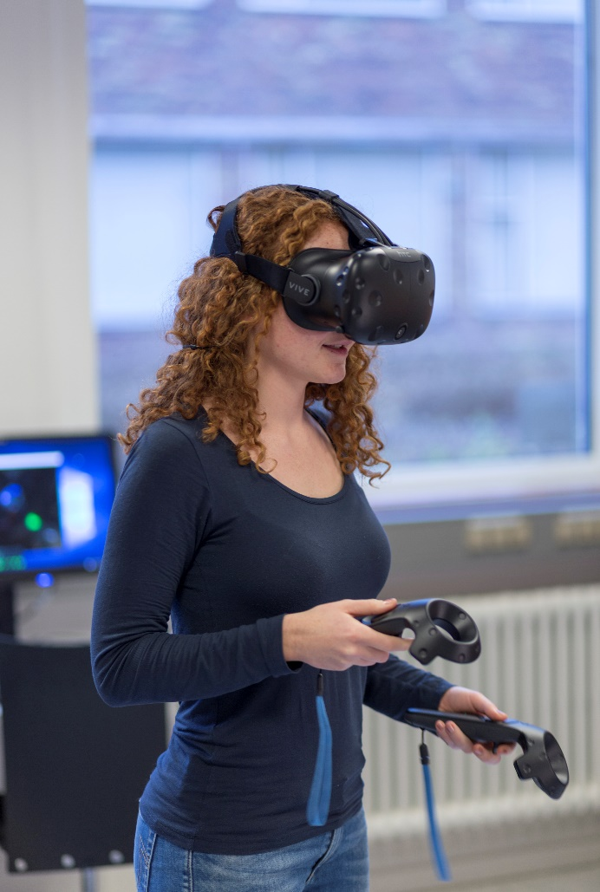
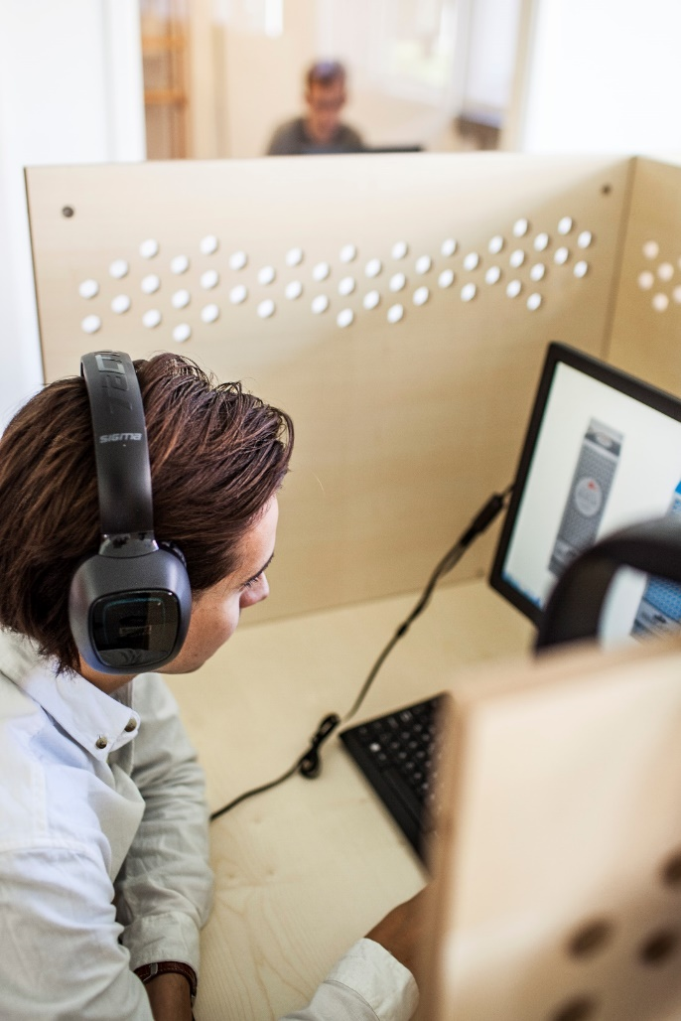
FIND US BSS.AU.DK/CBL

