Slide 1
Aarhus bss winter school and more by Katrine Rosenbeck, Aarhus BSS International

Slide 2
Aarhus university
A comprehensive, public university established in1928
Aarhus BSS
Faculty of Arts
Faculty of Health
Faculty of Science and Technology
42,500 students
4,000 international students
120 student nationalities
60+ degree programmes taught in English

Slide 3
Aarhus bss, Aarhus university
A broad business school committed to internationalisation
16,000+ students
1,500 international students
600 exchange students
150 courses taught in English

Slide 4
Rankings and accreditations
Aarhus BSS A triple crowned business school – among only 76 worldwide (2016)
EQUIS
AMBA
AASCB
Aarhus University A Top ranked University
No. 65: Shanghai Ranking (2017)
No. 101: Leiden Ranking (2017)
No. 98: Times Higher Education World University Ranking (2016)
No. 119: QS World University Ranking (2017)

Slide 5
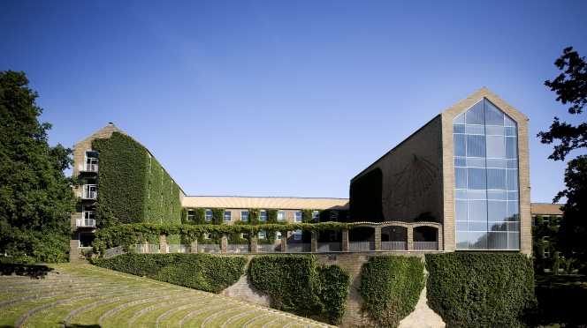
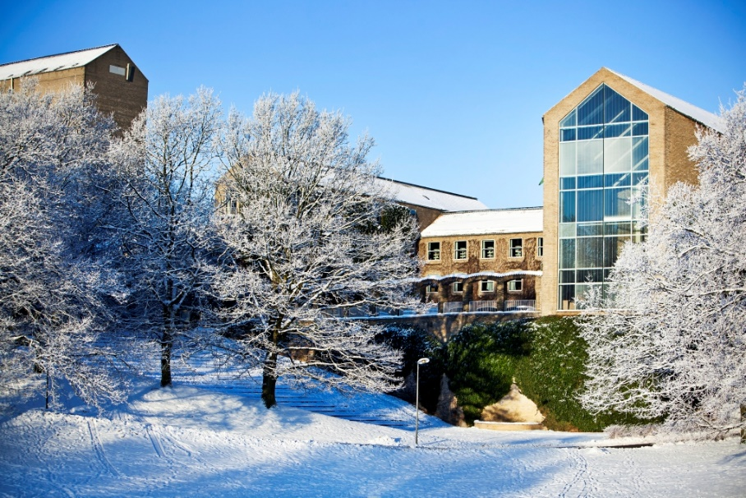
campus

Slide 6
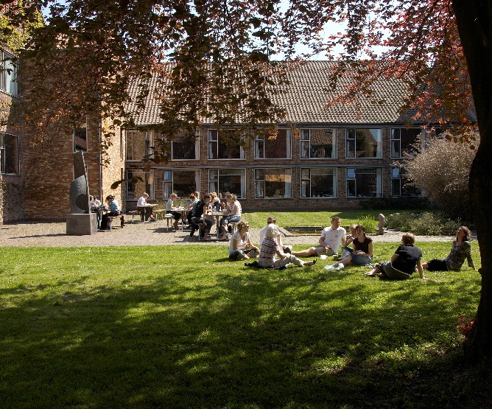

Slide 7
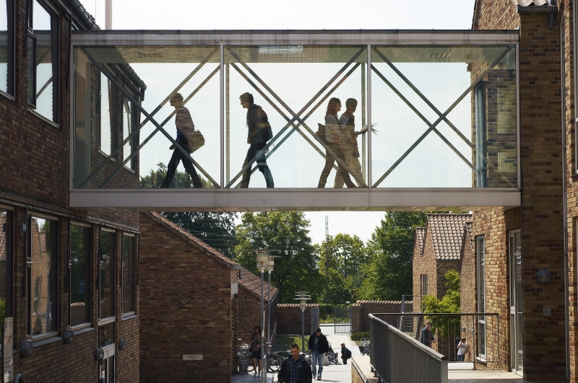
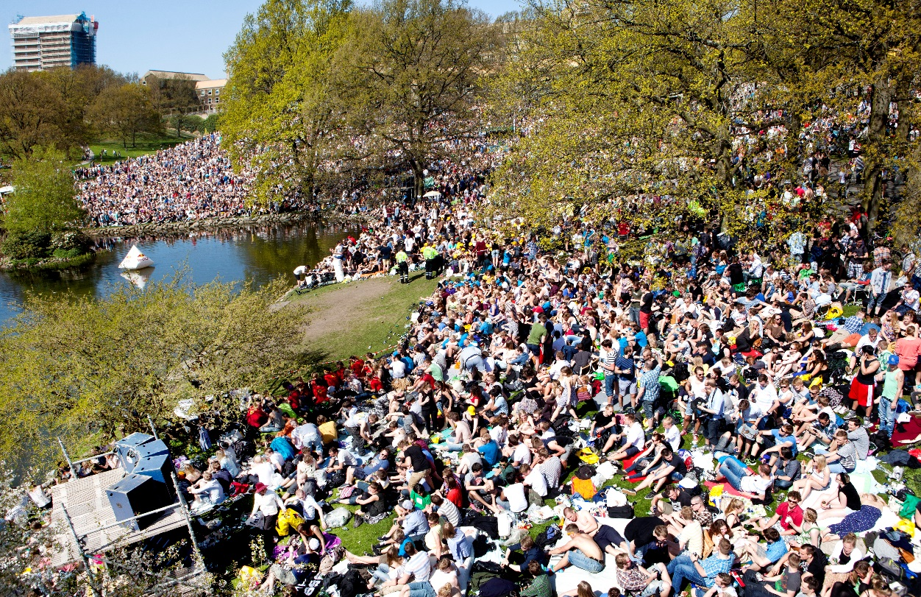
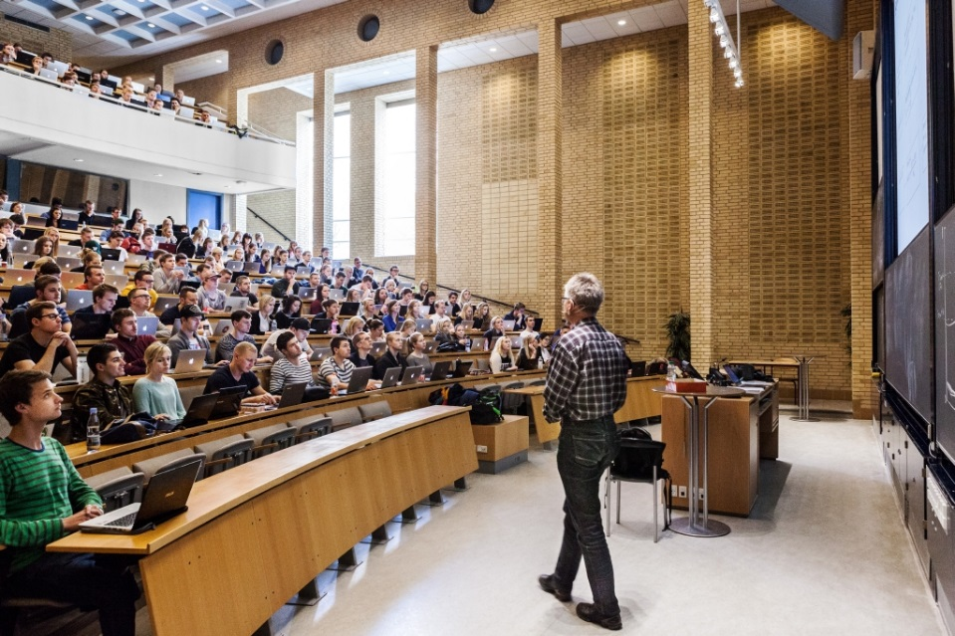

Slide 8
Exchange at aArhus bss
You are welcome at any time for both short term or full semester exchange:
Aarhus BSS Winter School (Week 2+3 of January)
Spring Semester (Late January-June)
AU Summer University (July or August)
Autumn Semester (Late August-December)
A Combination of a Short Term and Full Semester
- You just need to be nominated by your home university.

Slide 9
Aarhus Bss winter school
When: Monday January 8 to Friday January 19, 2018
How: Nomination required (ask home university for details)
Who: Most participating students come from Australian partner universities
What: Choose 1 of 3 courses offered
Why: Earn credits at a top uni while experiencing beautiful Aarhus and making new friends
What else? Be prepared: Bring your laptop and a warm coat (parka style). Imagine you were going skiing and pack for that.

Slide 10
Climate law – international and EU law in context
- a major legal challenge of the modern world
For students interested in the European Union, international and EU Law, climate change, and how a complex legal environment impacts the way people, organisations and businesses operate in a global world.

Slide 11
Branding and advertising in complex markets
- breaking through the commercial clutter
For students interested in marketing, branding, consumers
and/or communication and in developing
an understanding of a society driven by an evergrowing
marketisation.

Slide 12
Danish and European Business in a Global Perspective
- how to be successful in the global world
For students interested in commerce, business,
Europe, the European Union and how the corporate
sector is affected by an increasingly globalised
world.

Slide 13
Course info
10 ECTS is awarded for each course
Mixture of lectures, classroom workshops, discussions and exercises
2 part exam: 3-hour on site exam + a home assignment
Students get a Certificate of Attendance + a Transcript of Records
More info: bss.au.dk/winterschool

Slide 14
2018 winter school – social programme
Included
Welcome Breakfast
Guided City Tour
Welcome Dinner
The Old Town Open Air Museum
Farewell Reception
Optional
Guided Tour of Aros Art Museum
A Taste of Danish Christmas
TBA….
And we have so many more suggestions for you about what to see and what to do in Aarhus☺

Slide 15
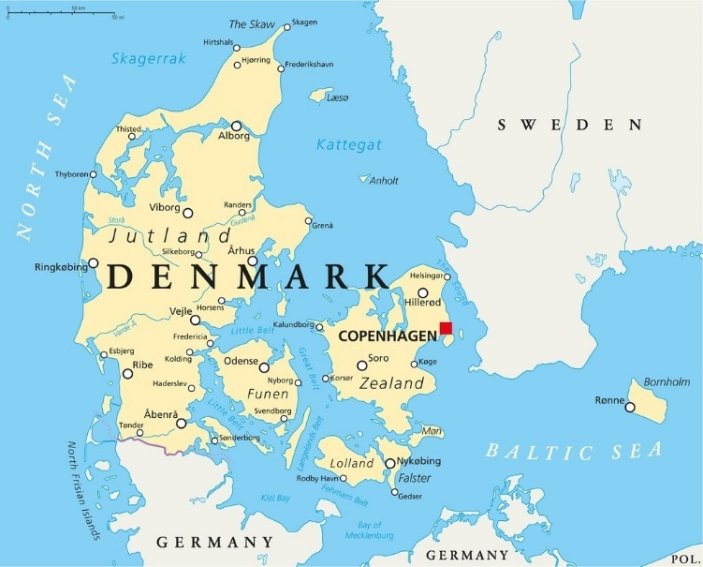
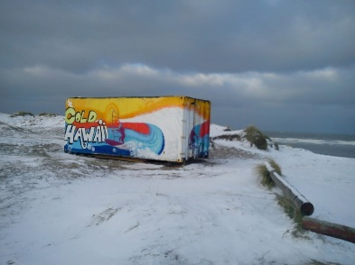
DENMARK
Population: 5.75 mil.
Capital: Copenhagen
Language: Danish (but everyone speaks English)
Currency: Danish Krone (DKK)
Established: App. 500 AD
1 peninsula and 440+ islands
Bonus info: Denmark actually has a place to surf called Cold Hawaii - The best beach in Scandinavia for surfing! Also, we talk a lot about the weather. And about “hygge”.

Slide 16
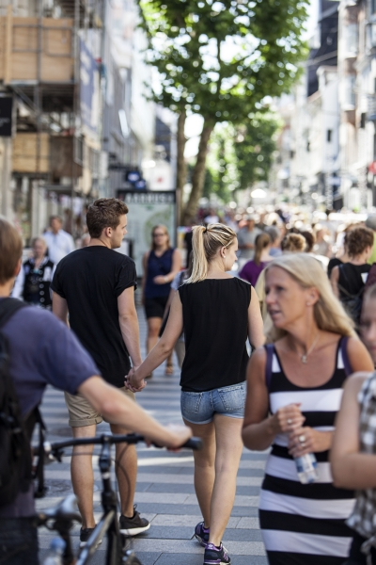
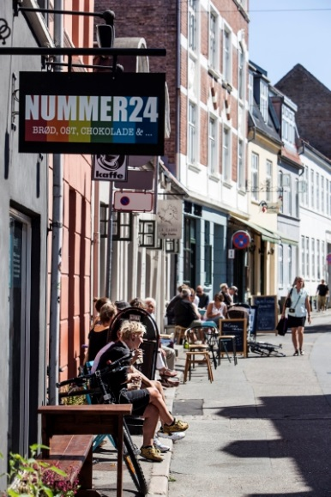
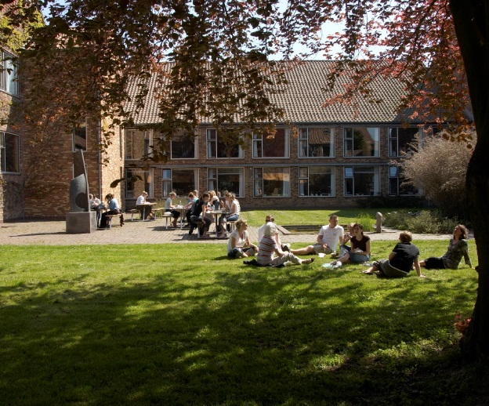
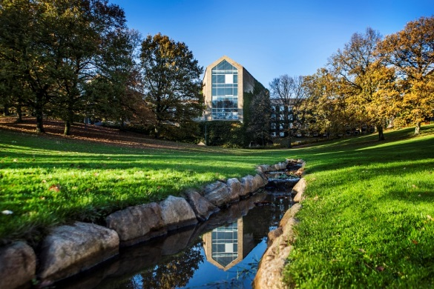
Summer

Slide 17
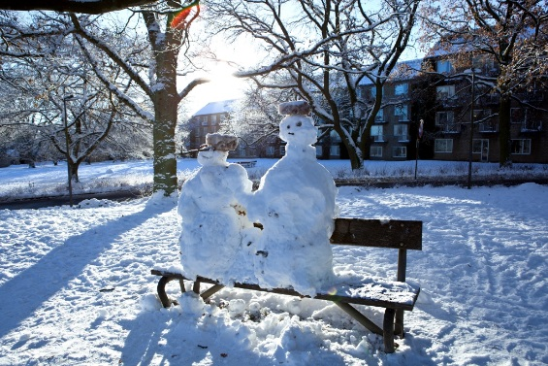
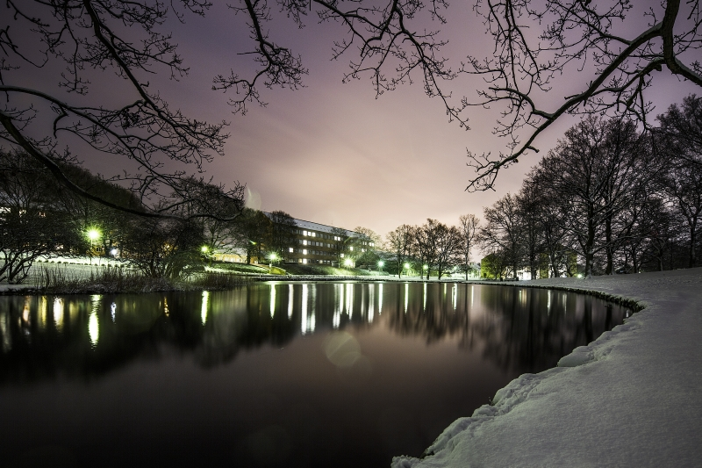
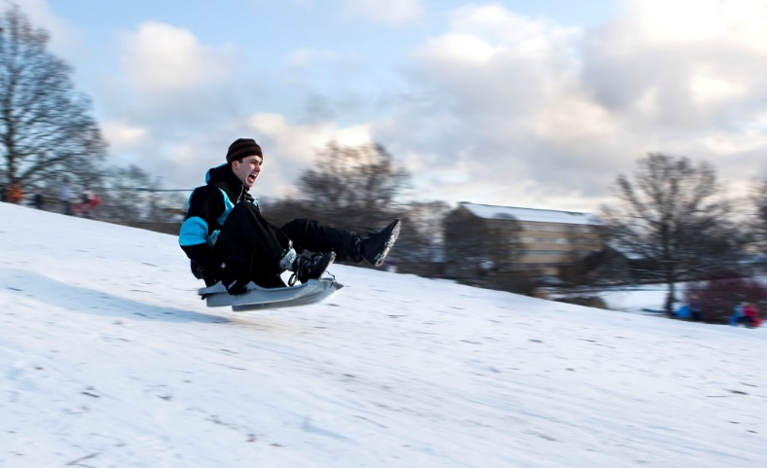
Winter

Slide 18
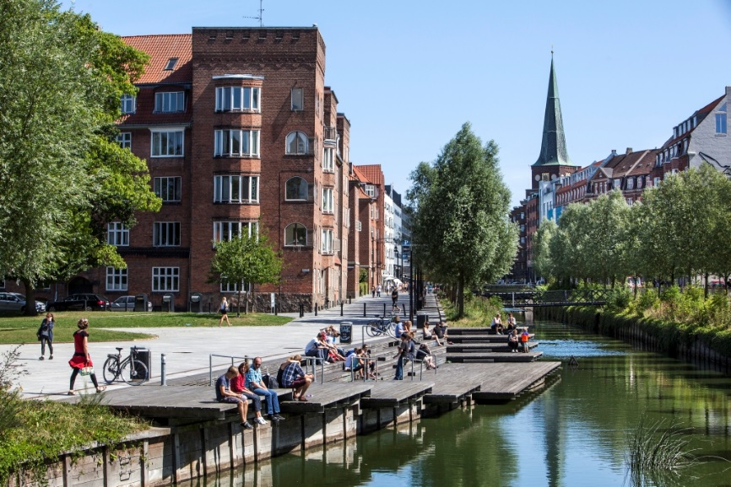
Aarhus
One of the oldest cities in Denmark, founded around year 700
The second largest city in Denmark
320.000 inhabitants (8.5% international)
15% students - Student capital of Denmark
A green city situated by the sea and surrounded by forests
Viking heritage

Slide 19
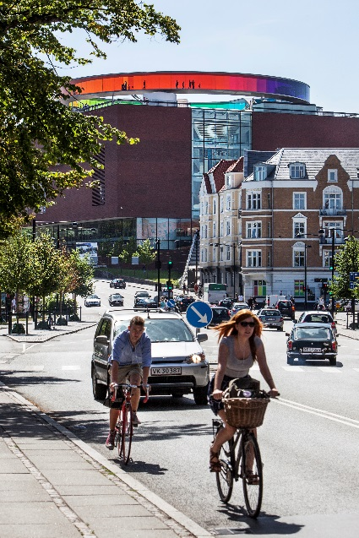
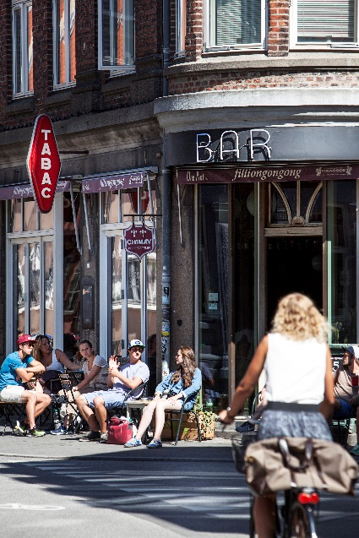
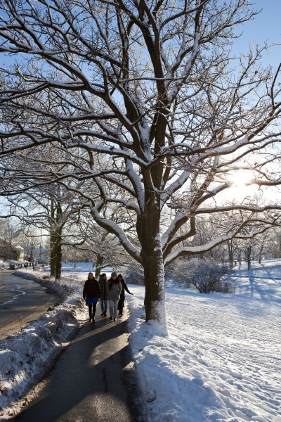
Aarhus
Music, Culture, Shopping and Social life
Great Music scene (Festivals!)
Several Art and History Museums
The Best Student Friday Bars in the World (the only?)
City for foodies
Excellent Shopping

Slide 20
Budget (monthly)
Housing: 2500-5000 DKK (330-670 Euro// 500-1000 AUD)
Living: 2000 DKK (265 Euro // 400 AUD)
Other: 1500 DKK (200 Euro // 300 AUD)
Keep down expenses by doing it the ”Danish way”:
Cook your own meals, walk/bike instead of using public
transport and keep an eye out for student deals when
going out ☺

Slide 21
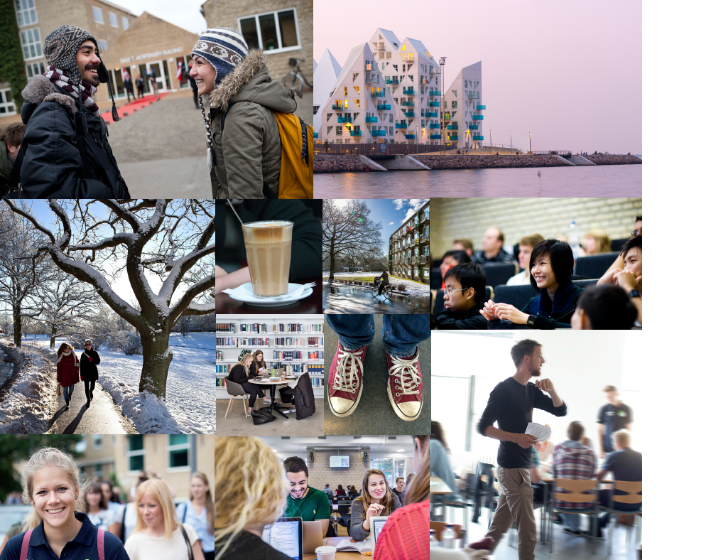
What’s it like?
Watch……

Slide 22
Questions?
Contact: Katrine at kabr@au.dk

